Slide 1
Project 2 : Cellular response to drug perturbations

Slide 2
NCI Transcriptional Pharmacodynamics Workbench
NCI-60-Cell line
12,704 genes
2 concentrations ( c_{max} , GI₅₀)
15 drugs → Erlotinib
Comparison untreated and treated transcriptional expression

Slide 3
Broad analysis
Expression profiles: density plots and box plots
treated vs. untreated
Down- and upregulated genes separately
PCA: cell line treated with all drugs
which drug has most influence on FC?

Slide 4
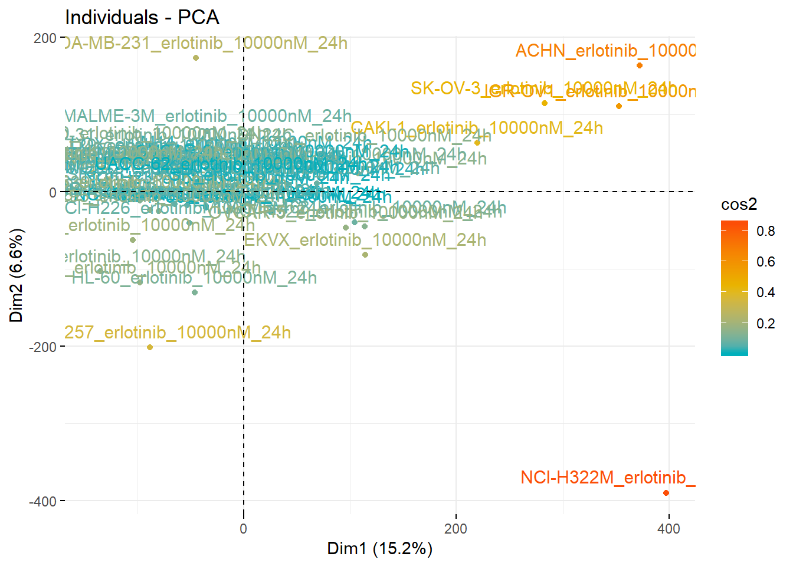
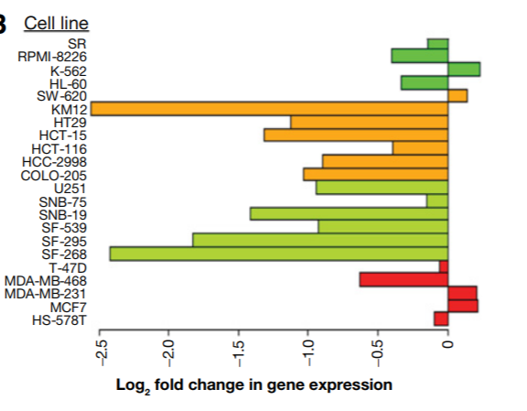
1. Milestone – Which genes and cell lines are most regulated by erlotinib?
Calculate FC
Cell lines:
Greatest variance in FC
Via PCA
Genes:
MA plot (of one cell line)
Volcano plot (FC against FDR)
Single gene response plot
Notes:
Differences between cell lines are more relevant to expression than drug treatment in PCA -> Treated (logarithmic data) - untreated (logarithmic data)
three most regulated genes
for 15 cell lines and colour the cancer type

Slide 5
2. Milestone – Does the fold change correlate with cell growth inhibition?
Calculate the median of gene expression changes of the most influenced cell lines
Paired t-test: Wilcoxon signed rank test
Pearson Correlation with FC and GI50
→ linear regression
→ compare with 6h timepoint (Fig. S2)

Slide 6
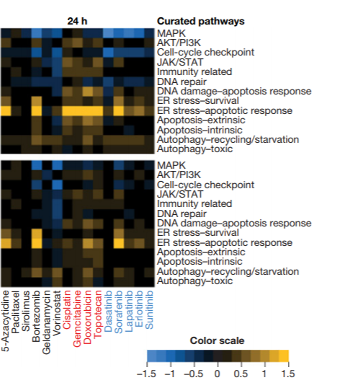
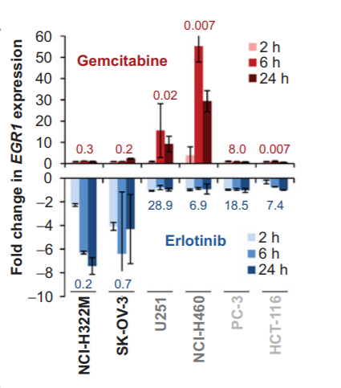
3. Milestone – Which cellular pathway’s are influenced by erlotinib?
Use PROGENy or NCI Supplementary Table S2 to determine, which cellular pathways are affected
Heatmap: cell-lines vs. pathways
(median of FC of relevant genes)
Comparison with other drugs
15 Cell lines

Slide 7
Timeline
12 Weeks
with 2 weeks for each mile stone
4 weeks at the end to interpret the data and come up with future investigations, which could provide novel insight

